Slide 1
The Enigma Machine
Sending secret, “uncrackable” messages in World War II

Slide 2
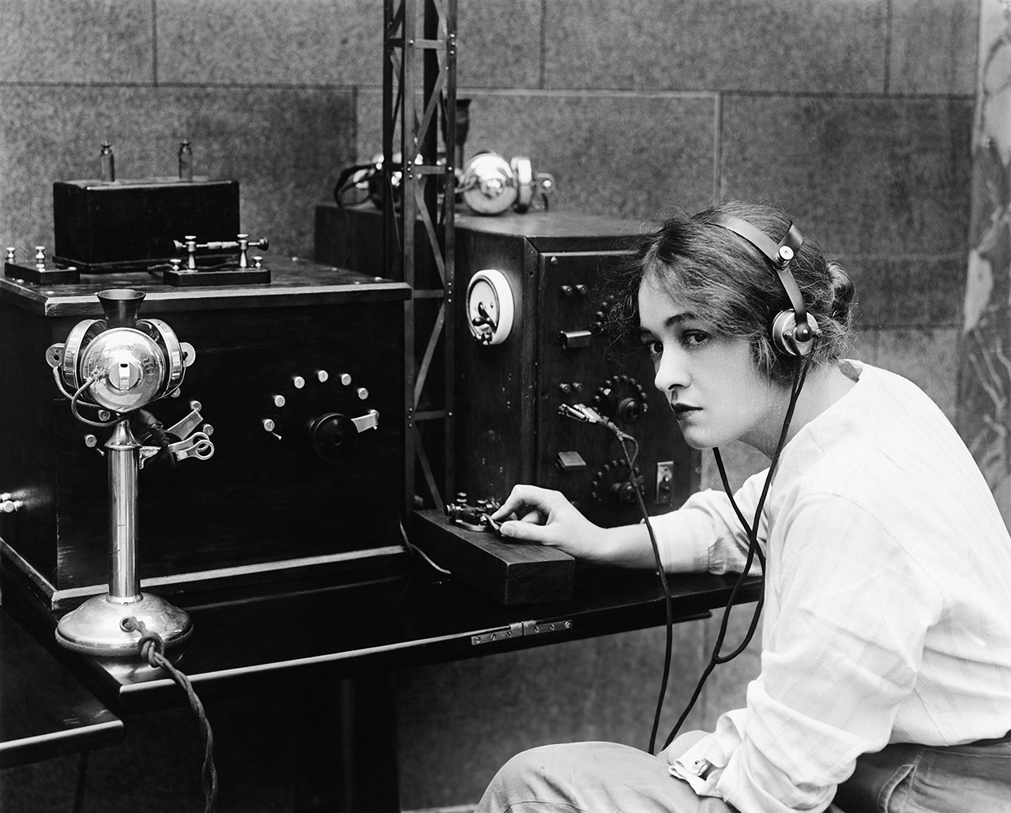
Imagine you’re Britain in 1937…
You need a way to communicate with your armies
You can use a telegraph to send Morse code over the radio, but the enemy can intercept your messages You need a way to encrypt your messages so that only your armies and your allies will understand
Enter… cryptography!

Slide 3
Some quick vocab
Cryptography – the science of encrypting and decrypting messages into cipher text
Encryption – converting plain text into cipher text
Decryption – converting cipher text into plain text
Plain text – the original message that you can ready normally
Cipher text – the secret message that you cannot read normally
Key – the algorithm or settings used to encrypt and decrypt

Slide 4
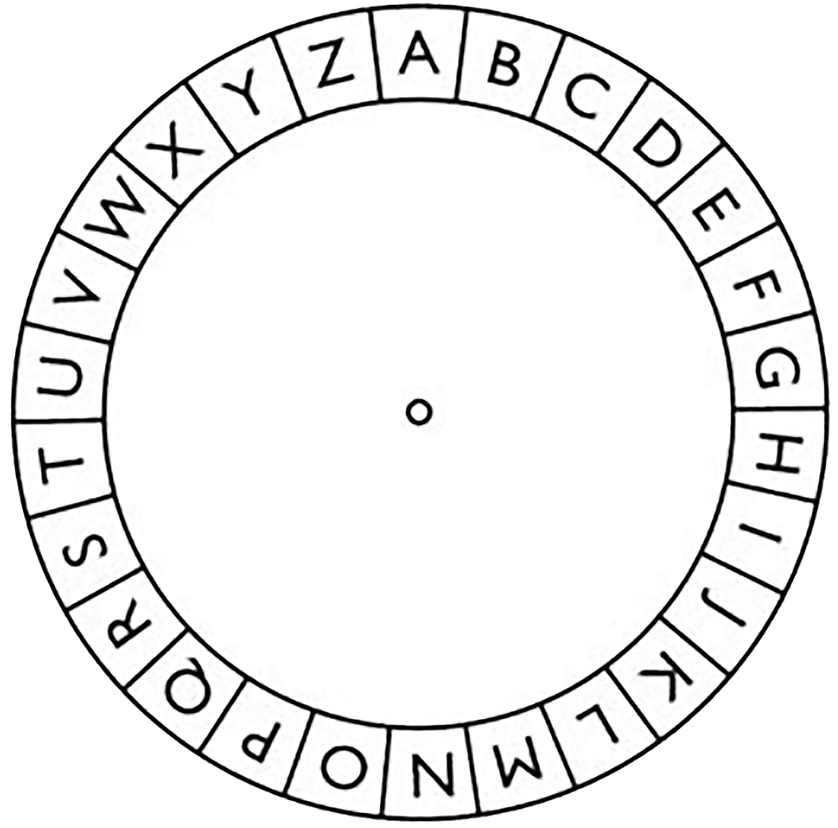
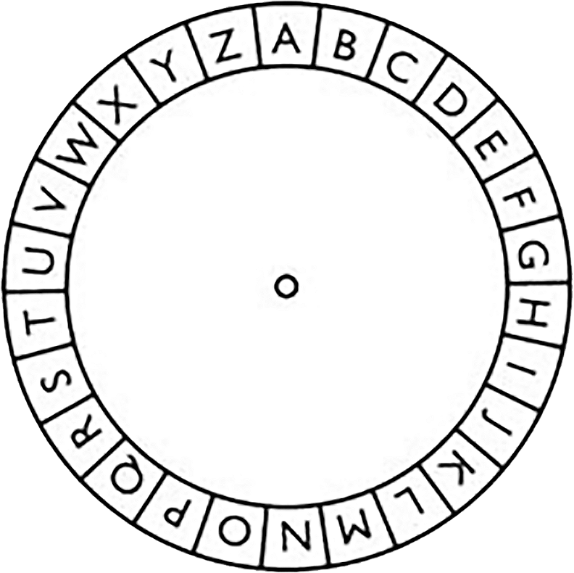
The simplest cipher is a shift cipher
Each letter maps to a new letter
The letters stay in order – the key is just a rotation (a shift) of the inner wheel
For example, if we shift from A on the outer wheel lining up with A on the inner wheel (key = 0) to A on the outer wheel lining up with C on the inner wheel…

Slide 5
The simplest cipher is a shift cipher
The key is now 2, since A has been shifted by 2 letters
If we rotate further, so A is now lined up with O (the fifteenth letter of the alphabet)…

Slide 6
The simplest cipher is a shift cipher
The key is now 15, since A has been shifted by 15 letters
Now let’s encrypt a message. The plain text is “TROOPS TO POLAND”
T on the outer wheel lines up with H on the inner wheel
R lines up with F
O lines up with C…

Slide 7
The simplest cipher is a shift cipher
“TROOPS TO POLAND” becomes “HFCCDG HC DCZOBR” with key = 15
If whoever receives that cipher text has the key, they can decrypt it by finding the letters on the inner wheel
H on the inner wheel lines up with T
F lines up with R
C lines up with O…

Slide 8
Class practice!
Decode this message: “CSY KSX MX VMKLX”
Note that the key is now 5

Slide 9

Now you will create your own cipher wheel
Cut out the outer and inner wheels and connect them with a fastener
Create a secret message and pass the cipher text and key to a partner – make sure your message is school appropriate
Decode your partner’s secret message using your own cipher wheel

Slide 10
The shift cipher is not very strong
How many possible keys are there?
How long do you think it would take to crack the algorithm, even if you didn’t know the key?
How could the cipher be strengthened?

Slide 11

Notes:
Also https://www.youtube.com/watch?v=Hb44bGY2KdU

Slide 12
158,962,555,217,826,360,000
That’s how many different keys there are for the Enigma Machine
Even if you cracked it in a day, the key would already have changed
Compared to the 26 keys of the shift cipher, this certainly seems nearly uncrackable

Slide 13
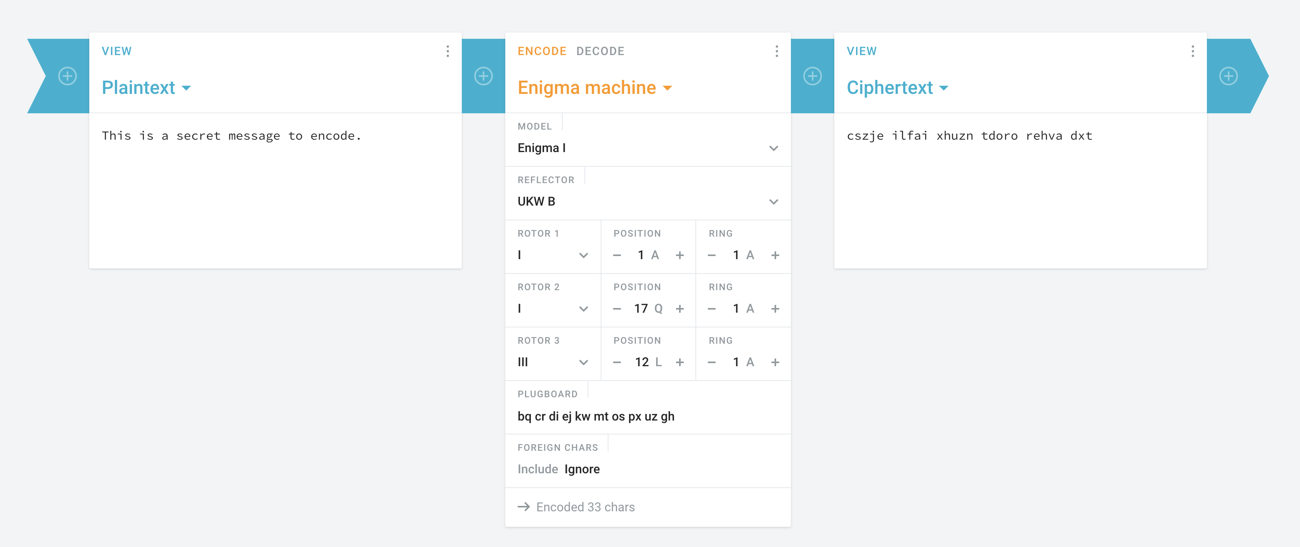
https://cryptii.com/pipes/enigma-machine
Notes:
Clicking on this lets you change which cipher disks you are using

Slide 14
Try out the Enigma machine!
Go to: https://cryptii.com/pipes/enigma-machine
Create a secret message and pass the cipher text and complete key to a partner – make sure your message is school appropriate
Decode your partner’s secret message using your own cipher machine

Slide 15
